Slide 1
The Effect of Emotions on Economic Decision-Making
MAS 630: Affective Computing
Javier Hernandez Rivera
javierhr@mit.edu

Slide 2
Contents
Motivation & Project Goals
Background
Experimental Setting
Data Synchronization & Visualization
Preliminary Data Analysis
Conclusions

Slide 3
Motivation
&
Project Goals

Slide 4

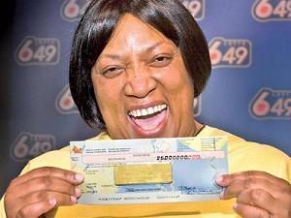
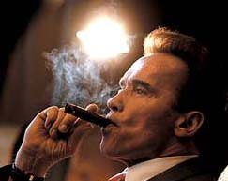


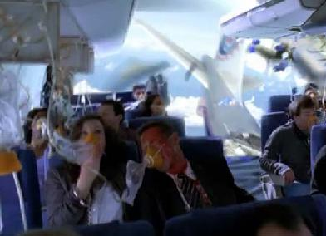
Affect in Decision Making
Emotions have been long neglected in decision making (DM) in favor of a deliberative and reason-based decision making
Why? Affect can lead us to irrational decision making (ignoring the odds or negative consequences)
(Shafir, Simonson, & Tversky, 1993)
Playing
the lottery
Happy
Makes People
Feel
Relaxed
Smoking
Flying
by plane
Fearful

Slide 5






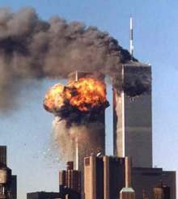
Project Goals
What?
Validate current economic DM theories (e.g.,Somatic Marker Hypothesis) in different settings
Understand how negative emotions (fear and anger) affect the DM process
How?
Emotion elicitation
Two-armed Bandit task
Electrodermal activity (EDA)
Why?
Understand the role of emotions in DM
Explore the benefits and limitations of most common emotional responses to catastrophes

Slide 6
Background

Slide 7
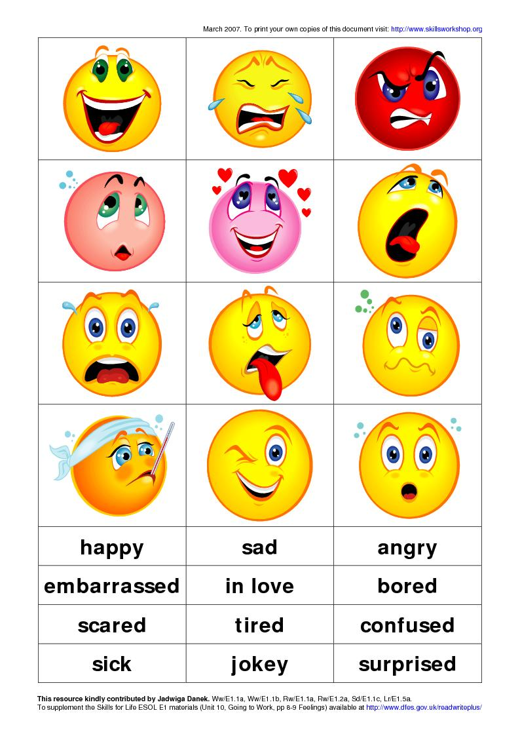



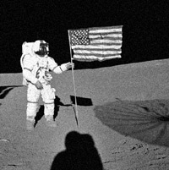
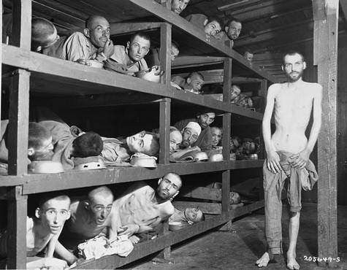

Roles of Emotions in Decision Making
1) Minimize negative emotions
2) Emotions as common currency
vs
3) Encode and recall information
Positive
Negative
4) Motivator of information processing and behavior
(Peters E., Vastfjall D., Garling T. & Slovic P, 2006)

Slide 8



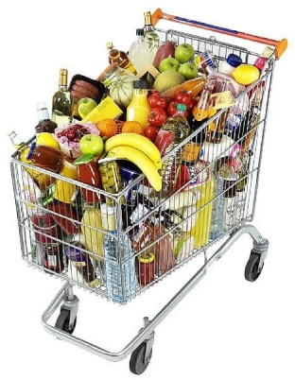
Factors that Influence Decision Making
Time¹
Uncertainty^{2,3}
Perceived
value
time
Risk^{3,4}
Visceral States
Ownership
Sexual Arousal⁵
Relaxed⁷
Hunger⁶
Disgusted⁸
Sad⁸
¹ (Lowenstein, 1992)
²(Bar-Anan., Wilson & Gilbert , 2009)
³(Lerner, & Tiedens, 2006)
⁴(MacGregor et al., 2005)
⁵(Ariely & Loewenstein, 2006)
⁶(Read & Leeuwen, 1998)
⁷(Pham, Hung, Gorn, 2011)
⁸(Lerner, Small & Loewenstein, 2004)

Slide 9
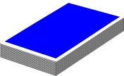
Decision Making and Physiology
Somatic Marker Hypothesis (SMH)
Theory: Physiological responses (a.k.a. somatic markers), learned in daily life activity, consciously or unconsciously influence the decision-making process.
(Bechara A., Damasio H., & Tranel D. 1991, 1997)
Experiment: Iowa Gambling task
A
B
C
D
x 100 Trials
Disadvantageous decks
Lead to overall loss
Risky option (high variance)
Advantageous decks
Lead to overall gain
Safe option (low variance)
Observation: Higher EDA responses before choosing risky and disadvantageous options, even before people could consciously identify the risky decks.

Slide 10
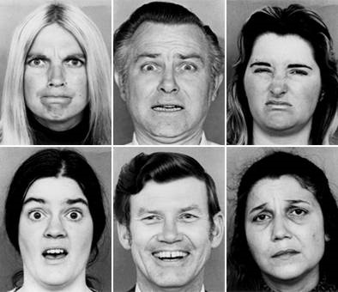
Anger and Fear
Most common emotional reactions after catastrophic events such as the terrorist attacks of 9/11 or the economical crisis
Anger
Fear
Appraisal to negative events¹
Certainty
Control
Uncertainty
Uncontrolled
Influence on Decision Making¹
Risk-seeking
Optimistic assessments
Risk-averse
Pessimistic assessments
Physiologycal
Responses²
Low
High
¹(Lerner and Keltner, 2000,2001)
²(Lerner, Dahl, Hariri & Taylor, 2006)

Slide 11
Experimental Setting
Designed & conducted by Hyungil Ahn
(Ahn, 2010)

Slide 12
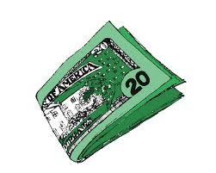
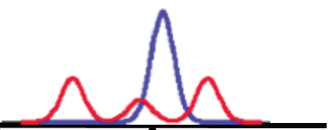
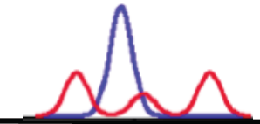
Experimental Setting
x 25 Trials
x 25 Trials
Neutral
Gain
Bet Money
Bet Money
Option 1
Option 1
Option 2
Option 2
Fear
Loss
-
+
-
+
Safe option
(low variance)
is better
Risky option
(high variance)
is better
Anger
Domain 1
Domain 2
Emotions
Ownership
Risk + Uncertainty

Slide 13
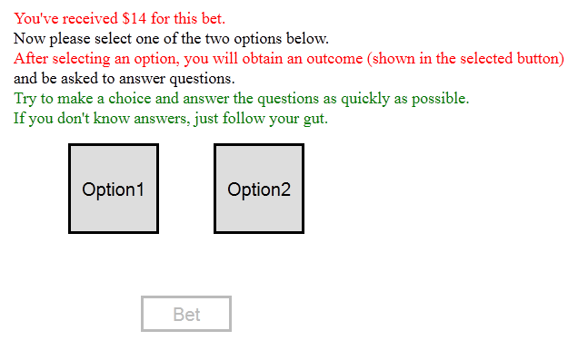

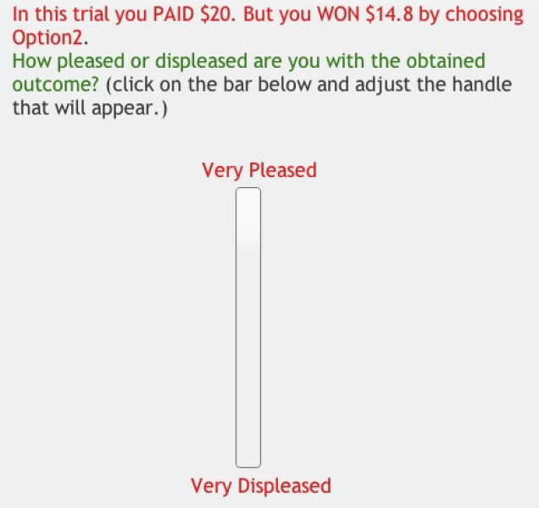
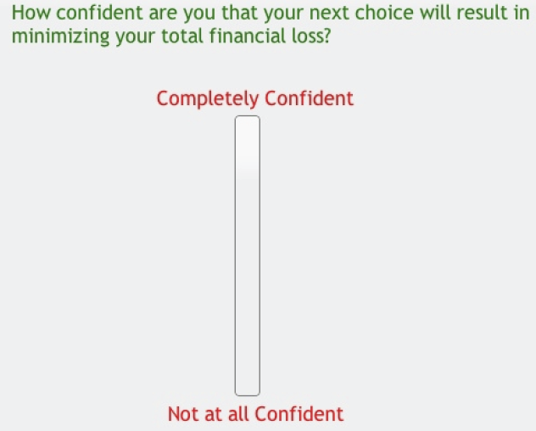
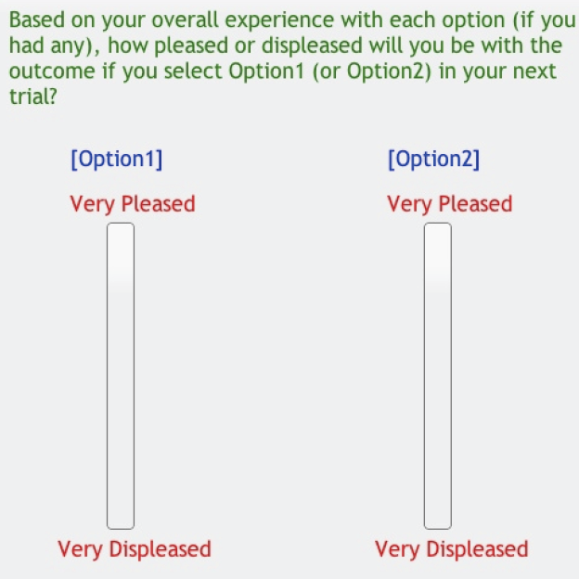
Experimental Setting: 1 Trial
1
1
2
3
4
5
6
EDA
3
Time
2
4
5
6

Slide 14
Data Synchronization
&
Visualization

Slide 15
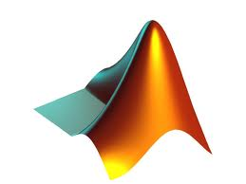

Data Synchronization
Filtering
Loss-pass filter
(0.16 Hz cutoff frequency)
Normalization
Scale each subject between
0 and 1
Number of Participants
EDA
(20 Hz)
 | Neutral | Anger | Fear
Gain | 3 | 3 | 5
Loss | 4 | 5 | 5
Frames
15 participants were excluded because of corrupted signals
(artifacts, low response)
Surveys
 | Neutral | Anger | Fear
Safe | 7 | 8 | 10
Risky | 7 | 8 | 10
Best Option
20 participants were excluded because of missing information
x
25
participants
2
sessions
1250
trials
=
Task Activity

Slide 16
Data Visualization (Neutral)
Video
Risky Option is Better
Video
Safe Option is Better
Selected Options
(‘1’ is always
the optimal selection)
Gain
Frame
(3 participants)
Data in
Neutral
7 participants
(350 trials)
Loss
Frame
(4 participants)

Slide 17
Data Visualization (Anger)
Risky Option
is Better
Safe Option
is Better
Video
Video
Gain
Frame
(3 participants)
Data in
Anger
8 participants
(400 trials)
Loss
Frame
(5 participants)

Slide 18
Data Visualization (Fear)
Video
Safe Option is Better
Video
Risky Option is Better
Gain
Frame
(5 participants)
Data in
Fear
10 participants
(500 trials)
Loss
Frame
(5 participants)

Slide 19
Preliminary
Data Analysis

Slide 20
Behavioral Responses: Speed
Standard Error of the Mean (SEM)
Trial
1
2
3
4
5
6
EDA
Average Trial
Response Time (sec)
Time
*
*
Betting
Surveys
Neutral
(N = 350)
Anger
(N = 399)
Fear
(N = 500)
People answer significantly faster in the negative emotional states, and fearful people are significantly faster than angry people.
* Statistically Significant (Two Sample T-Test)

Slide 21
Behavioral Responses: Performance
Advantageous
Disadvantageous
Overall, people in the three emotional conditions perform similarly.
Negative states are slightly better when the safe option is the optimal one, but they are slightly worse when the risky option is the optimal one.
Fearful people tend to perform slightly better than angry people
Safe Option
Is Better
% of
Selections
*
*
Risky Option is Better
*
*
*
Neutral
Anger
Fear
* Statistically Significant (Two Sample T-Test)

Slide 22
Behavioral Responses: Risk Preference
Non-Risky Option
Risky Option
Although people in the neutral state significantly choose riskier options, people in the negative states prefer non-riskier options.
In the loss frame, people prefer the riskier options. The difference is significant for the neutral and fear settings.
Gain
Frame
% of
Selections
*
*
Loss
Frame
*
*
Neutral
Anger
Fear
* Statistically Significant (Two Sample T-Test)

Slide 23
Behavioral Responses: Pleasantness
Gain Frame
Loss Frame
Angry people in the loss frame perform slightly better than angry people in the gain frame.
Average of the % of
Advantageous Selections
As expected, the overall pleasantness ratings on the outcomes are slightly lower in the loss frame. Moreover, angry people are surprisingly unpleased even though they obtained slightly higher outcomes.
Average of Pleasantness
Ratings on the Outcomes
Neutral
Anger
Fear
Neutral
Anger
Fear

Slide 24
Preprocessing for EDA Analysis
Filtering
Loss-pass filter
(0.16 Hz cutoff frequency)
Baseline Removal
Smoothed Minimum Sliding Window over 10 minutes
Normalization
Scale each subject between
0 and 1*
Feature Extraction
Normalized Area under the Curve
EDA
Original Signal
µS
Low-pass filtered signal
Baseline
Corrected signal
Minutes
*(Lykken, D.T., Venables, P.H, 1971)

Slide 25
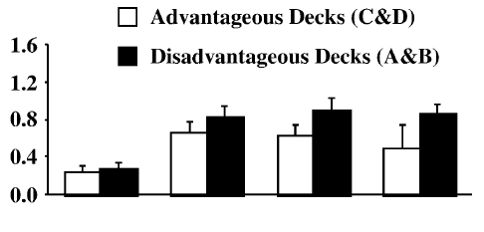
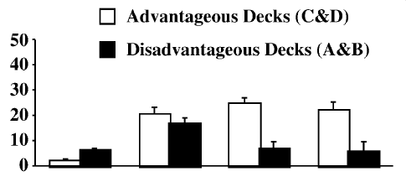
Anticipatory Responses: SMH
Iowa Gambling Task
Two-Armed Bandit Task
Safe Option Is Better
Safe Option Is Better
Risky Option is Better
Average Activation
Total # Selections
Pre-
Punishment
Pre-
Hunch
Conceptual
Period
*
*
*
*
Hunch
1-8
9-17
18-25
1-8
9-17
18-25
Trials
The SMH hypothesis (higher EDA responses before disadvantageous selections) seems plausible when the Safe Option is optimal and it might be delayed when the Risky Option is the optimal one.
Advantageous
Disadvantageous
* Statistically Significant

Slide 26
Main Limitations of the Analysis
1) Reduced number of participants (35 part. were excluded)
2) Consecutive tasks distort EDA responses
1
2
3
4
5
6
Cognitive load of the first survey?
Too short to display anticipatory responses?
Average EDA response
(N: 1250 trials)
Betting
~4 sec.
Answering
Surveys
~16 sec.

Slide 27
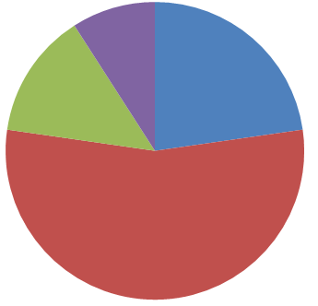
Conclusions
People in the negative states bet faster than people in the neutral state.
Fearful people bet faster and performed slightly better than angry people.
Although most of the people preferred riskier options, angry and fearful people in the gain frame preferred safer options.
Angry people performed slightly better in the loss frame.
Angry people were less pleased in the loss frame even though they obtained relatively higher outcomes.
Although the SMH seemed plausible in the Two-armed Bandit Task, further analysis is required.
Time Distribution
Deliverables
Readings
Data
Analysis
Data Synchronization

Slide 28
References I
Ahn, H.I. (2010). Modeling and Analysis of Affective Influences on Human Experience, Prediction, Decision Making, and Behavior. MIT PhD Thesis.
Ariely D., & Loewenstein G. (2006). The Heat of the Moment: The Effect of Sexual Arousal on Sexual Decision Making. J. Behav. Dec. Making, (19), 87-98
Bar-Anan Y., Wilson T & Gilbert (2009) . The Feeling of Uncertainty Intensities Affective Reactions. Emotion 9, (1), 123-127
Bechara A., Damasio H., & Tranel D. (1997). Deciding Advantageously Before Knowing the Advantageous Strategy. Science.
Damasio, A. R., Tranel, D., & Damasio, H. (1991). Somatic Markers and the Guidance of Behavior: Theory and Preliminary Testing.
Lerner, J. S., Dahl, R. E., Hariri, A. R., & Taylor, S. E. (2007). Facial Expressions of Emotion Reveal Neuroendocrine and Cardiovascular Stress Responses. Biol Psychiatry; 61:,253-260
Lerner, J. S., & Keltner, D. (2000). Beyond Valence: Toward a Model of Emotion-specific Influences on Judgment and Choice. Cognition and Emotion, 14(4), 473–493.
Lerner, J. S., & Keltner, D. (2001). Fear, Anger, and Risk. Journal of Personality and Social Psychology, 81(1), 146–159.
Lerner, J. S., Small, D. A., & Loewenstein, G. (2004). Heart Strings and Purse Strings: Effects of Emotions on Economic Transactions. Psychological Science, 15, 337–341.

Slide 29
References II
Loewenstein, G. & Prelec, D. (1992). Anomalies in Intertemporal Choice: Evidence and an Interpretation. Quarterly Journal of Economics. 573-597
Lykken, D.T. & Venables, P.H.(1971) Direct Measurement of Skin Conductance: A Proposal for Standarization. Psychophysiology 8(5), 656–672
MacGregor, Slovic P, Peters P & Finucane M. (2005) Affect, Risk, and Decision Making. Health Psycholoy, 24 (4) S35-S40
Peters E., Vastfjall D., Garling T. & Slovic P. (2006). Affect and Decision Making: A “Hot” Topic. Journal of Behavioral Decision Making, 19, 79-85
Pham M., Hung I. & Gorn G. (2011). Relaxation Increases Monetary Valuations. Journal of Marketing Research, 48
Read & Lweeuwen (1999). Predicting Hunger: The Effects of Appetite and Delay on Choice. Organizational Behavior and Human Decision Processes, 76(2), 189-205
Shafir, E., Simonson, I., & Tversky, A. (1993). Reason-based Choice. Cognition, 49, 11-36.

