Slide 1
Final Project
Classification of Sleep data
Akane Sano
akanes@mit.edu
Affective Computing Group
Media Lab

Slide 2
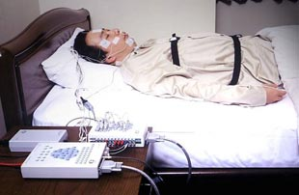
Polysomnography
Multi-parametric test to evaluate sleep

Slide 3
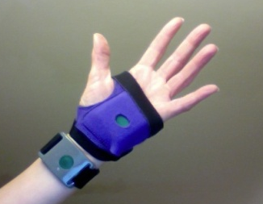
Data and Labels
Data:
  Healthy students (N=7)
  Electroencephalogram(EEG) 100Hz
  Electro dermal activity(EDA) 32Hz
  Motion 32Hz
Labels : sleep stages (every 30s)
(Wake, REM, NonREM1-4, Movements/Noise)
-> Wake, REM, Non-REM, Movements/Noise

Slide 4
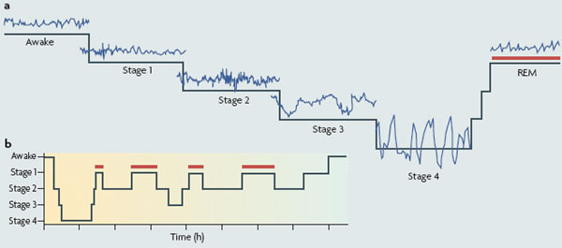
Sleep Stage
NREM

Slide 5
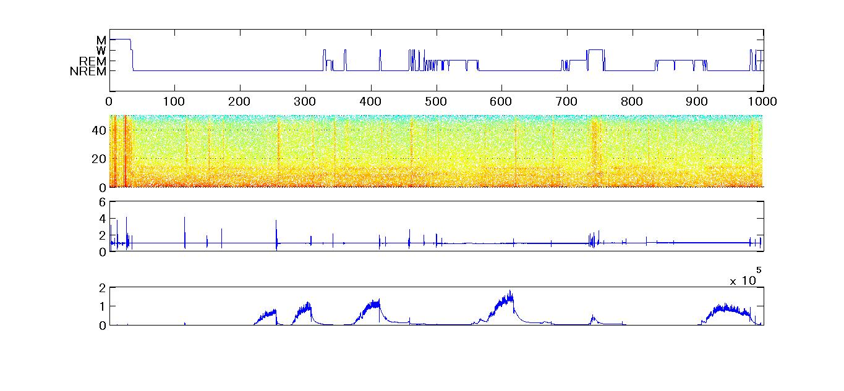
Sleep Stage
[Hz]
EEG
Motion
EDA

Slide 6
Questions
Which features are the best to estimate sleep stage?
How accurate can we estimate sleep stage from EDA and motion?

Slide 7
data
Subject | WAKE | REM | NREM | MOVEMENT
Q | 317 | 124 | 527 | 0
R | 15 | 141 | 719 | 3
S | 46 | 184 | 714 | 9
T | 10 | 189 | 630 | 0
U | 51 | 209 | 709 | 3
V | 38 | 203 | 703 | 5
W | 49 | 179 | 735 | 32
% | 8.0 | 18.8 | 72.4 | 0.8

Slide 8
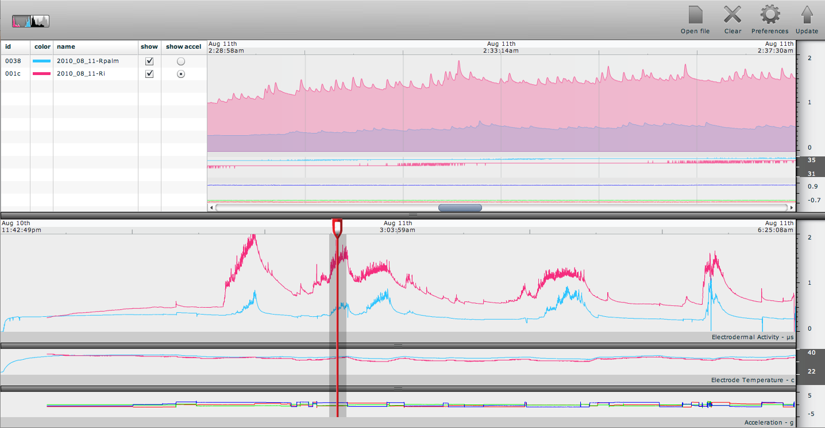
Features
Recorded signals were segmented into 30s window
Computed with MATLAB
EEG :
  Frequency Energy
    δ:0.5-4,Hz
    θ:4-8
    α:8-13Hz
    β:13-40Hz
    γ:40-50Hz)
Motion:
  Amplitude
  Standard Deviation
  Zero-crossing
  Frequency Energy
EDA :
  Amplitude (Normalized)
  Standard Deviation
  # of peaks
  Gradient
  Frequency Energy

Slide 9
Red Non-REM, blue Wake pink REM black M

Slide 10
Methods
Using Matlab
k Nearest Neighbors (k=1-199)
Support Vector Machine (libSVM)
  Linear
  Polynomial
  Radial Basis Function
  Dynamic features (still working)
Neural Network (n=2, 4, 6, 8, 10, 20)
Hidden Marcov Model / Baysian Network (still working)
  Gaussian Mixture Model (HMM toolbox Errors, Bayes Net toolbox : Errors)
  Discrete Model (HMM toolbox Errors)

Slide 11
Methods (cont.)
Leave one subject out
Compare Accuracy
  Classification Methods
  Features

Slide 12
Results – Accuracy [%] (SVM)
 | SVM
Features | Linear | Poly | RGB
ALL | 73.2 | 72.4 | 71.5
EEG | 71.3 | 72.6 | 69.9
EDA | 72.6 | 72.6 | 72.6
MOTION | 72.6 | 72.6 | 70.4
W | 0
REM | 0
NREM | 100
MOVE | 0
W | 30.7
REM | 32.1
NREM | 91.2
MOVE | 0
 |  | predicted
 |  | W | R | N | M
true | W | 0.3 | 0.1 | 0.6 | 0.0
 | R | 0.0 | 0.3 | 0.7 | 0.0
 | NR | 0.0 | 0.1 | 0.9 | 0.0
 | M | 0.3 | 0.1 | 0.5 | 0.0
misclassified to NREM

Slide 13
Results – Accuracy [%] (kNN)
Improved For ALL, EEG, but decreased for EDA and MOTION
features | kNN
ALL | 76.0 | n=137
EEG | 76.7 | n=9
EDA | 70.1 | k=199
MOTION | 70.3 | n=197

Slide 14
Results – Accuracy [%]
Neural Network
Improved!
Node # | Features
 | ALL | EEG | EDA | MOTION
2 | 82.8 | 85.2 | 72.6 | 72.5
4 | 84.9 | 85.6 | 72.5 | 73.1
6 | 84.9 | 86.1 | 72.9 | 73.1
8 | 85.1 | 86.8 | 73.0 | 73.3
10 | 85.5 | 86.5 | 73.7 | 73.4
20 | 86.0 | 88.2 | 74.0 | 73.3

Slide 15
Another Better Feature?
Added Elapsed time (0:Record Start-1:End)
SVM |  |  |  |  | kNN
 | Linear | Poly | RGB
ALL | 73.5 | 72.1 | 71.7 |  | ALL | 76.1
EEG | 72.2 | 72.6 | 70.9 |  | EEG | 75.5
EDA | 72.6 | 71.7 | 71.9 |  | EDA | 68.6
MOTION | 72.6 | 72.6 | 72.6 |  | MOTION | 70.0
Improved For ALL, EEG, but decreased for EDA and MOTION
0.3% UP!

Slide 16
Neural Network (Elapsed Time added)
Node # | Features
 | ALL | EEG | EDA | MOTION
2 | 84.3 | 83.1 | 73.0 | 73.8
4 | 86.6 | 85.7 | 72.4 | 73.6
6 | 86.7 | 85.0 | 73.9 | 74.3
8 | 87.4 | 85.7 | 74.4 | 74.0
10 | 87.5 | 86.4 | 74.2 | 74.3
20 | 87.6 | 89.2 | 74.8 | 74.8
Improved!

Slide 17
Best classifier
Neural Network(n=20)
EEG with elapsed time
 |  | Precited
 |  | W | R | N | M
True | W | 0.7 | 0.1 | 0.3 | 0.0
 | R | 0.0 | 0.8 | 0.2 | 0.0
 | NR | 0.0 | 0.1 | 0.9 | 0.0
 | M | 0.3 | 0.0 | 0.2 | 0.5

Slide 18
Summary
Node # | Features
 | ALL | EEG | EDA | MOTION
SVM | 73.2 | 72.6 | 72.6 | 72.6
kNN | 76.0 | 76.7 | 70.1 | 70.3
Neural | 86.0 | 88.2 | 74.0 | 73.4
SVM with time | 73.5 | 72.6 | 72.6 | 72.6
kNN with time | 76.1 | 75.5 | 68.6 | 70.0
Neural with time | 87.6 | 89.2 | 74.8 | 74.8

Slide 19
Conclusion
EDA and Motion showed less accuracy than EEG and ALL
Wake, REM, Movement were misclassified to N-REM
Neural Network showed the best accuracy
Elapsed Time might be effective
Future Work
  Temporal model
  Features

