Slide 1
Exploring Pressure Sensors through Sensing Sounds
Fawn Qiu

Slide 2
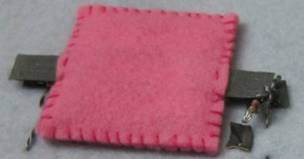
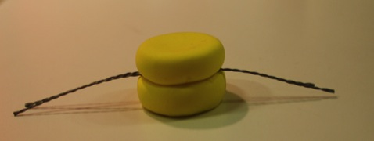
Pressure Sensor Overview

Slide 3
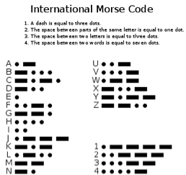
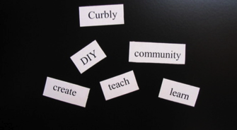
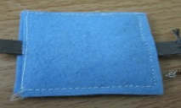
Felt Pressure Sensor as Audio Poetry Maker
“Hey”
“You”

Slide 4
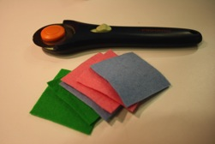
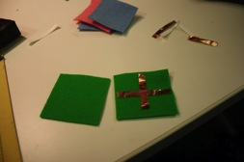
How to make a felt sensor
Felt pieces
Adhere conductive material to felt
Adhere resistive materials (velostat) between the conductive materials

Slide 5
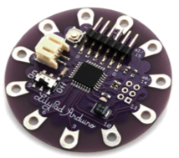
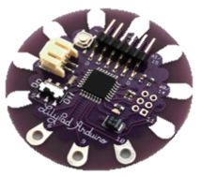
How to create unique identity for individual sensor
Difficulty to achieve unique range of voltage
Not able to achieve unique identity for each sensor
Use resistor as an identifier

Slide 6
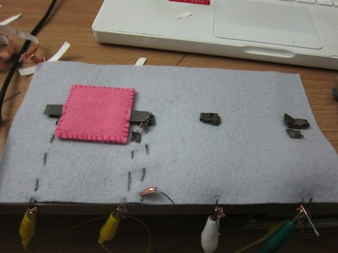
Testing
Potential solutions:
Construct sensors to provide unique voltages
Create unique visualization on processing for each sensor
Better construction of connection points
Challenges
Communicate my idea through processing was a challenge
Future application:
Word pieces for visually impaired or people with reading challenges
Sensor 1

Slide 7
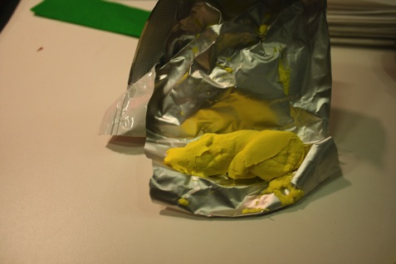
Model clay sensor
Idea: the two nonconductive surface would adhere tightly together
Model Clay
Velostat
Conductive material

Slide 8
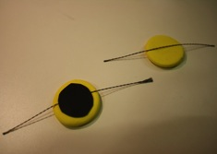
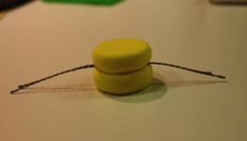
How to make a model clay sensor

Slide 9
Testing
Single sensor
Multiple sensors

Slide 10
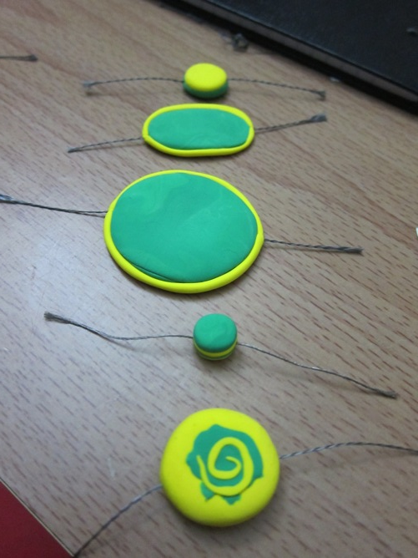
Application
Toys
Crafts
Jewelry

