Slide 1
Laser Cut Wool Vest Rachel Batzer
Final Project: A professional style women’s vest with laser cut lace appliqué based on a vornoi digram of a lissajous curve and a prolate cycloid.

Slide 2
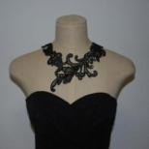
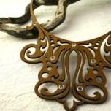
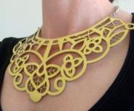
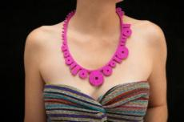
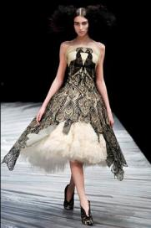
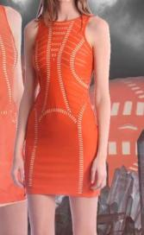
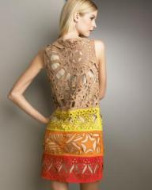
Previous Work (not including references for laser lace assignment)
Necklaces on Etsy:
Clothing
http://www.etsy.com/listing/96674218/lace-eco-necklace-black-swirly-delicate
http://www.etsy.com/listing/91034151/filigree-laser-cut-leather-necklace-in
http://www.etsy.com/listing/83470519/yellow-leather-necklace-laser-cut-lace
http://www.etsy.com/listing/44229462/binary-necklace-pink
Emilio Pucci
Alexander McQueen
Giles Deacon
unknown

Slide 3
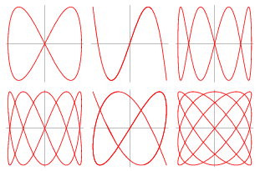
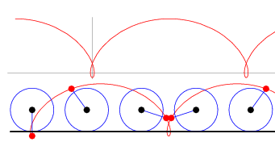
Vest Design: Voronoi diagram based Mathematical Curves
Lissajous curve on the back
x = sin(a*t+ θ)
y = sin(b*t)
Prolate Cycloid
x = a*θ – b*sin(θ)
y = a – b*cos(θ)

Slide 4
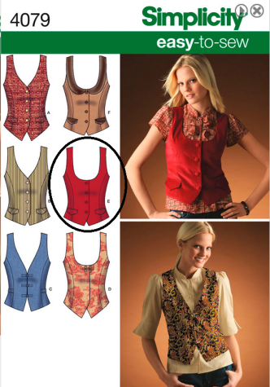
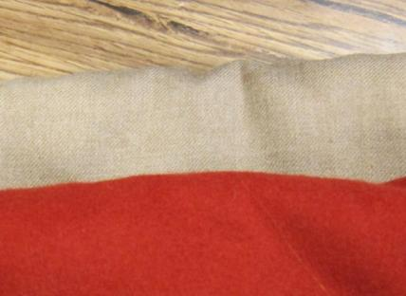
Material and Pattern
Red wool felt and tan wool cloth

Slide 5
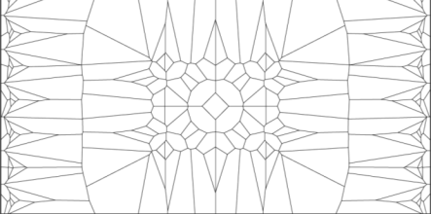
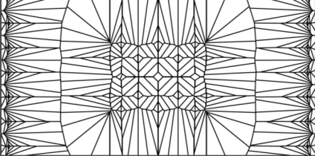
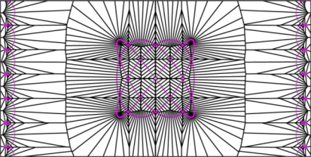
Processing Design
Varying numbers of points and spacing on the cycloid.
The lissajous curve is the Lincoln Labs logo.

Slide 6
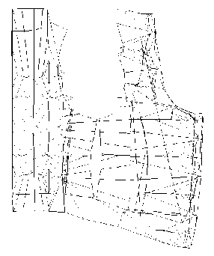
Map 2D diagram to vest pattern
Measure vest pattern and put in SolidWorks
Line up edges close together
Move individual lines so that the lines will touch at the seams.
Extend lines to account for seams.

Slide 7
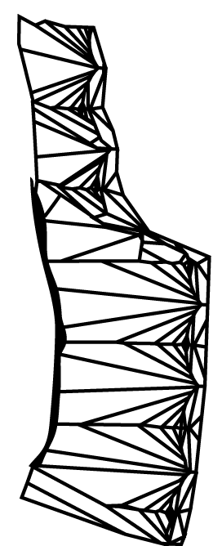
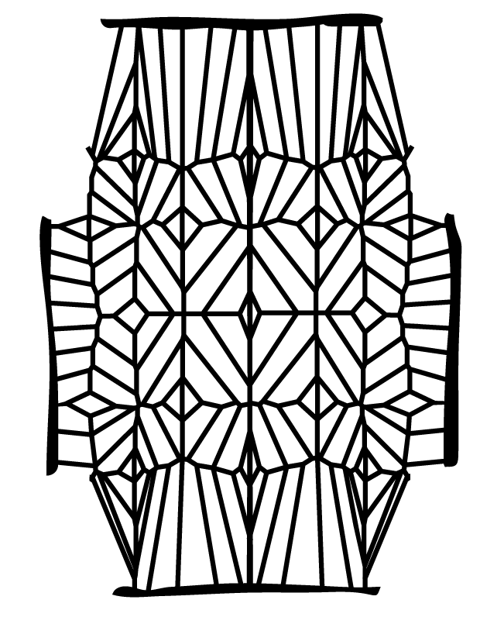
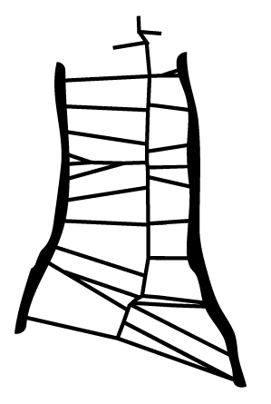
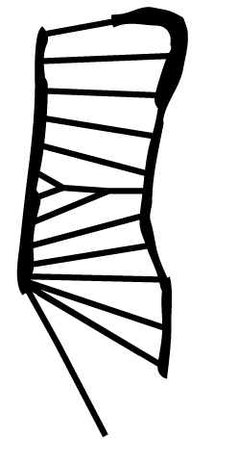
Cut Patterns

Slide 8
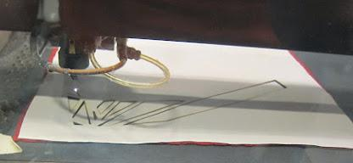
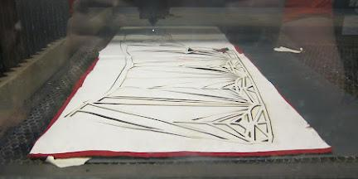
Laser Cutting
Iron-on fusible added before cutting
Cut with paper side up to minimize burning
Smells terrible!

Slide 9
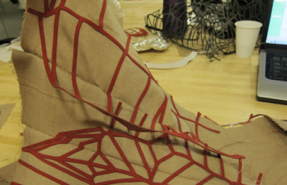
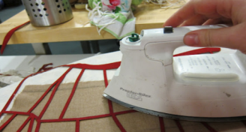
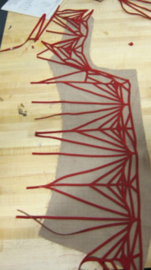
The Fun Part: Making the patterns line up at the seams
Cut patterns seam to be a little too large making fitting difficult
Below is the simplified version:
Line up patterns on the front and back panel
Iron down
Line up middle two patterns
Iron down remainder

Slide 10
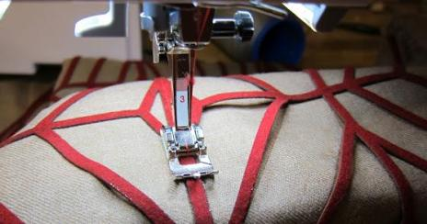
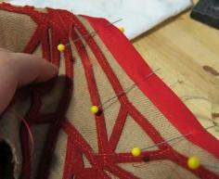
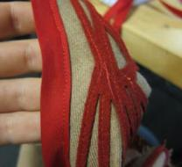
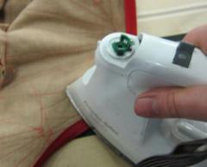
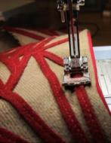
Finishing Touches
Sew over the pattern: more stable than iron-on alone
Complete edges with bias tape

Slide 11
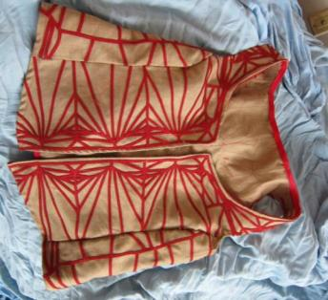
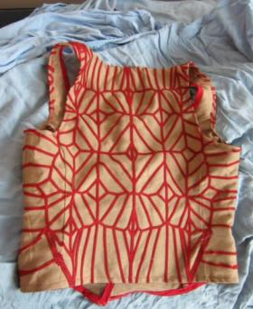
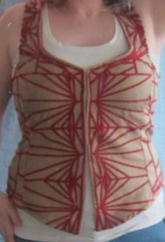
Finished Vest

Slide 12
Future Work
Full 3D modeling of design so parts line up better
More complete fitting of pattern to person before pattern desing.

